Slide 1
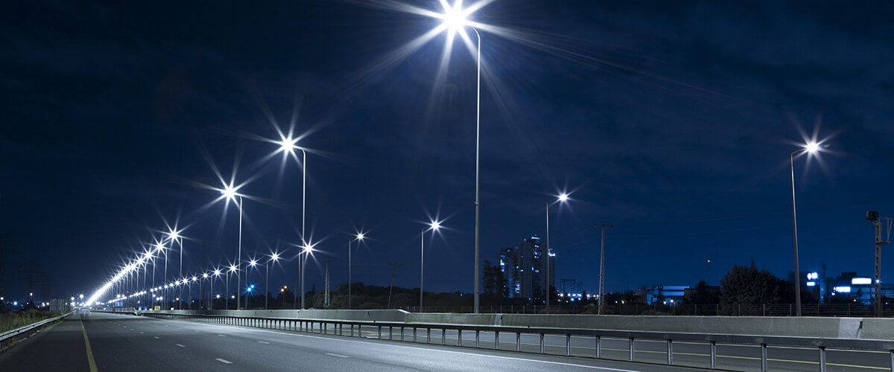
SMART STREET LIGHTING

Slide 2

Introduction
Smart street light system tries to find solution for the faster depletion of energy resources due to the inefficient usage and wastage of these resources. Increasing electricity bill is something that can be witnessed by these practices. This project helps to decrease the wastage of electricity by controlling the working of street light system that attributes to a good amount of electricity bills in our nation. This project does not include methods to incorporate usage of renewable resources like solar energy, it involves –
Automatic switching of street lights considering the intensity of sunlight.
Automatic switching of lights on detecting an obstacle.
It includes two modules, the sunlight sensing, obstacle sensing and control of ON/OFF of the lights.

Slide 3
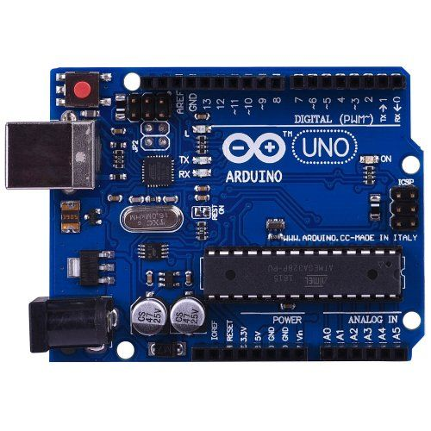
Microcontroller used:
Microcontroller used is Arduino uno r3 atmega 328p, which has to be programmed for the two tasks mentioned earlier. Inputs for the same come from the two sensors, output include instruction to ON/OFF the control system.

Slide 4
System for controlling on/off of lights:
Use Case Description:
Sunlight intensity less than 250 lux.
Sunlight intensity greater than 250 lux.
Flow of events:
If the intensity of the light is less than 250 lux then switch on the lights Else switch off the light.
Use Case Description:
Obstacle detected.
Flow of events:
Lights automatically switches on when the obstacle is detected by the sensor and switches off when the obstacle passes by.

Slide 5
Advantages of Smart Street lightning system:
If we use this idea and implement to it in our society it will be helpful in saving enough amount of electricity and off-course money.
This system helps to reduce manual labour as it does not require constant monitoring and maintenance of the lights.

Slide 6
OVERALL DESCRIPTION
Todays modern world people preferred to live the sophisticated life with all facilities. The science and technological developments are growing rapidly to meet the above requirements. With advanced innovations, Internet of Things (IoT) plays a major role to automate different areas like health monitoring, traffic management, agricultural irrigation, street lights, class rooms, etc., Currently we use manual system to operate the street lights, this leads to the enormous energy waste in all over the world and it should be changed.
IoT is used to develop the street lights in the smart way for our modern era. It is an important fact to solve the energy crises and also to develop the street lights to the entire world. In addition with the study on smart street lighting systems we analyzed and described different sensors and components which are used in IoT environment. All the components of this survey are frequently used and very modest but effective to make the unswerving intelligence systems
Predominantly, street lights plays the vital role in the urban areas where the main purpose is to improve the streets throughout shady periods of the daytime. Before hand, the quantity of streets in the cities and towns were very fewer but by the growth of urban areas, the quantity of streets growths quickly with high traffic concentration

Slide 7
Smart Street Light System is a manageable and strong idea, which is utilized to switch ON/OFF of the street lights automatically. Whenever the sunlight is decreased lights were automatically switched ON. The lights are switched OFF by monitoring the luminous level of sunlight in the self- regulating Manner. This work is performed by an LDR sensor which monitors the light absolutely like our eyes. The system itself spots whether there is necessity for light or not. When the progress of darkness is increases to a destined level then street lights were automatically switched ON, otherwise it gets OFF.
The system is also capable of switching the lights ON and OFF on detection of an object (i.e. cars). It is possible due to the use of obstacle detection sensor. Whenever a car passes by this sensor it sends a signal towards the street light making it turn ON and after passing of the vehicle it automatically switches OFF saving the power consumed.
The sensitiveness of the street light can also be adjusted. In our project we have used LEDs as a symbol of street lamp.
The output has only two states high and low and cannot remain in any intermediate stage. It is powered by an AC source.
LDR (Light Dependent Resistor) is a special type of resistor whose value depends on the brightness of the light which is falling on it. It has resistance of about 1 mega ohm when in total darkness, but a resistance of only about 5k ohms when brightness illuminated. It responds to a large part of light spectrum. Since, voltage is directly proportional to conductance so more voltage we will get from this divider when LDR is getting light and low voltage in darkness.

Slide 8
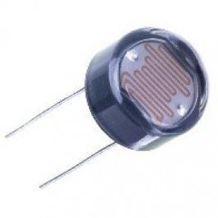
External Interface Requirements:-
3.1 USER INTERFACES
We use the C programming language to operate our Arduino.
Arduino basically is an open source hardware and software company,project, and user community that designs and manufactures single-board microcontrollers and microcontroller kits for building digital devices.
3.2 HARDWARE INTERFACES
1.LDR Input
A LDR also termed as a photoresistor is a device whose resistivity factor is a function of the electromagnetic radiation.
2.IR Sensor
An infrared sensor is an electronic instrument that is used to sense certain characteristics of its surroundings by either emitting and detecting infrared radiation.

Slide 9
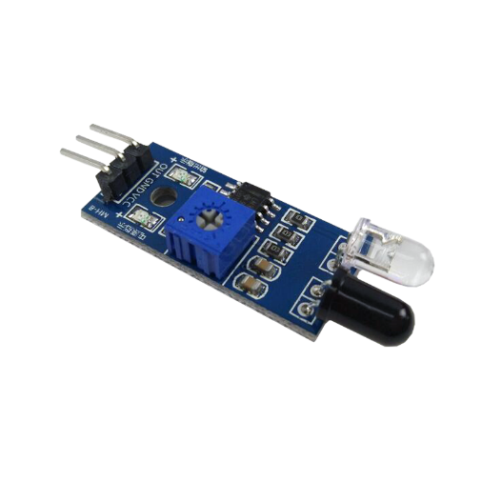
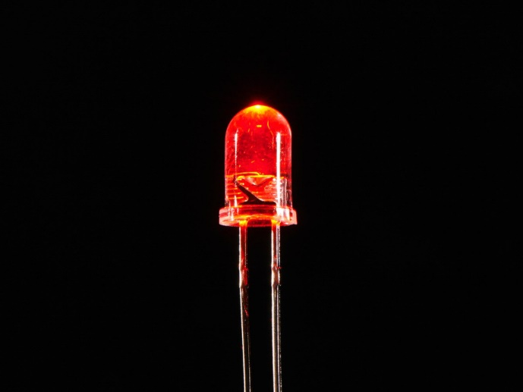
IR SENSOR
3.LED
A LED is a junction diode which emits light when activated.When we apply voltage across its leads,electrons are able tore combine with holes within the LED,releasing energy in the form of photons which gives the light.

Slide 10
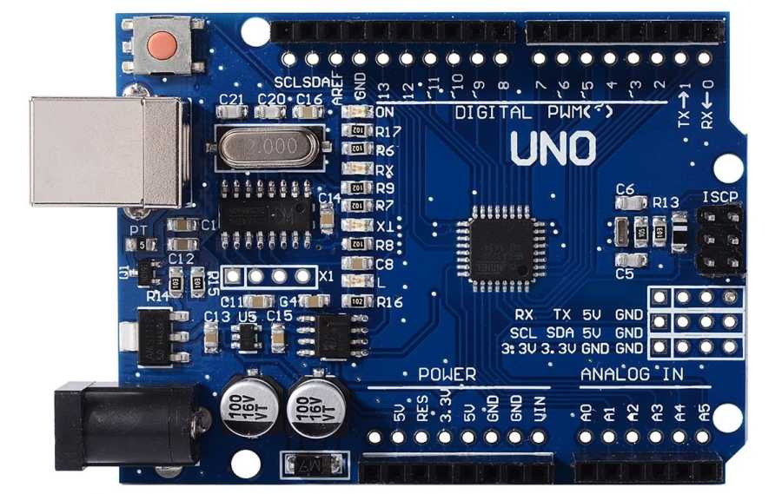
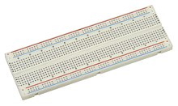
4.ARDUINO
Arduino basically is an open source hardware and software company,project, and user community that designs and manufactures single-board microcontrollers and microcontroller kits for building digital devices.
5.BREAD BOARD
A breadboard is a construction base for prototyping of electronics

Slide 11
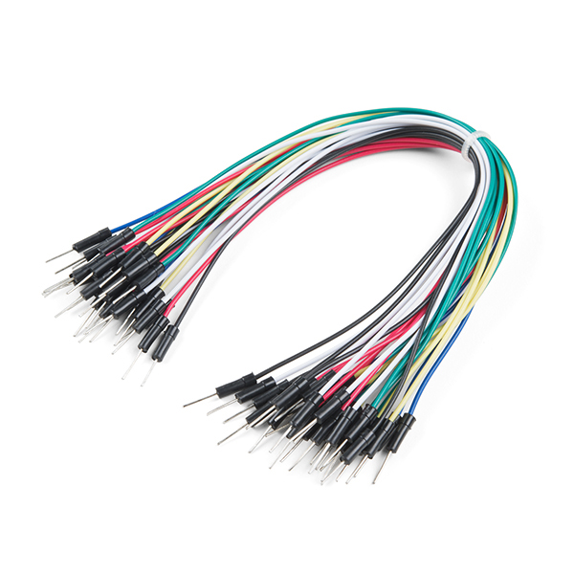
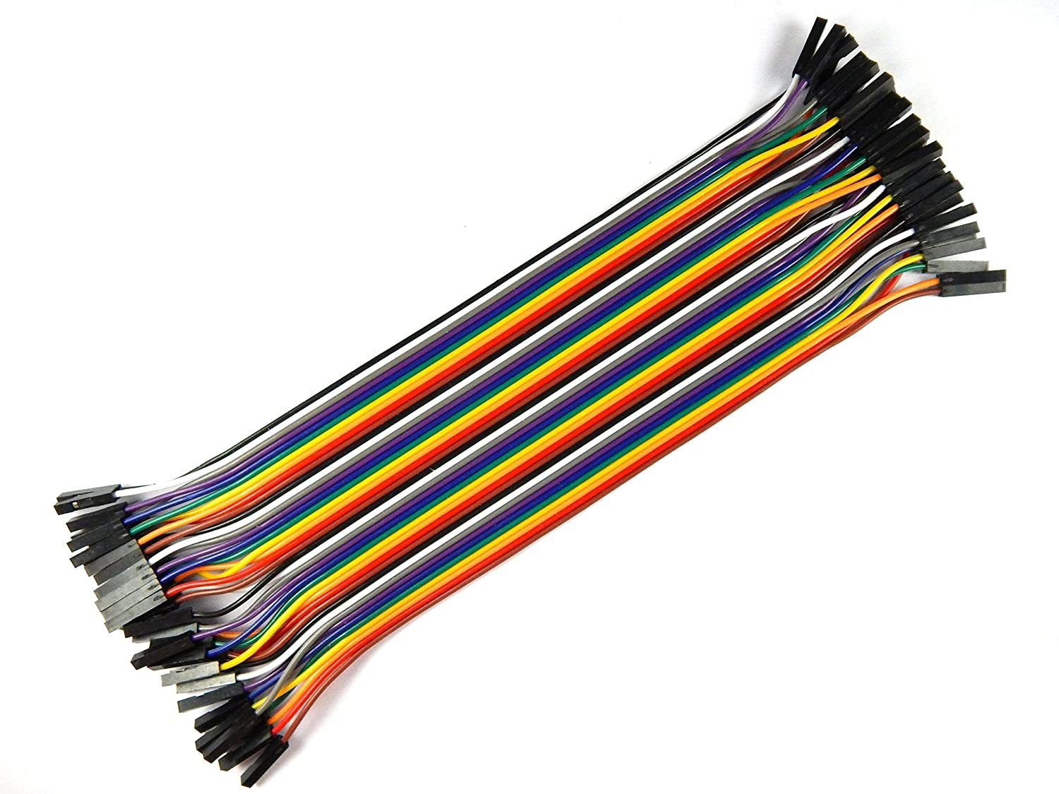
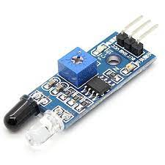
6. JUMPER WIRES:-
For connecting with breadboard
7.Obstacle Detection Sensor
a) Male jumper wire b) Female jumper wire

Slide 12
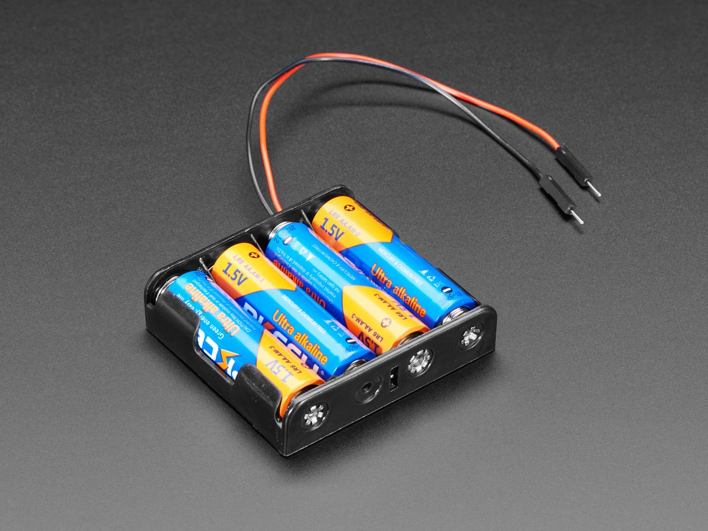
8.Power Supply
3.3 Model Requirement
For preparing model we use chart paper thermocol and many things that make our project creative.

Slide 13
Features of smart streetlights:-
While the features of smart streetlights depend on the specific technology used by city planners, examples of common functionality include the following:
dynamic lighting controls based on movement detection.
environmental and weather monitoring.
digital signage that can update as needed, such as parking regulations or accident alerts.
parking management, such as alerting officials of illegally parked vehicles or drivers of open spaces
extended cellular and wireless communications.
traffic management through real-time data feeds that track congestion and speed.
And automatic emergency response in the event of a car crash or crime.

